Slide 1
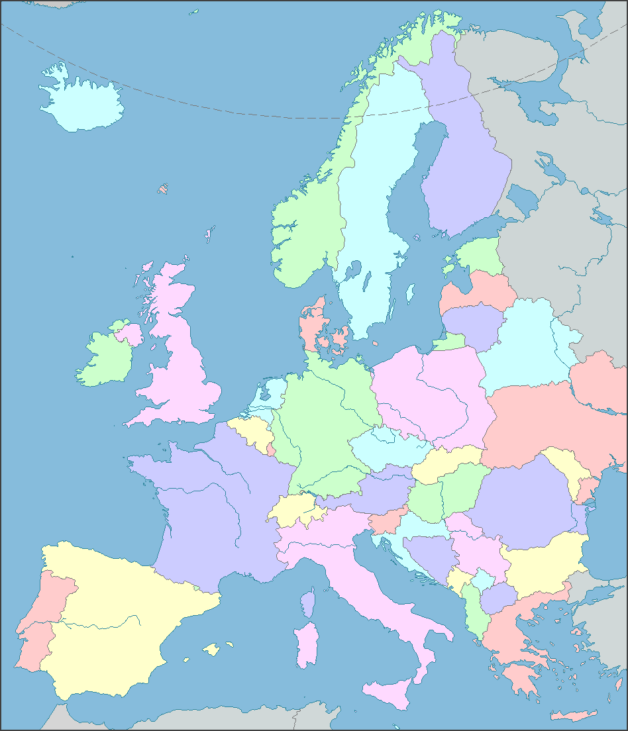
Fast methods for authentication of organic plant products
KU-Science
FOOD-DTU
DVFA
Bioforsk
UHEL
FERA
UEA
LIAE
RIKILT
Project coordinator:
Professor Søren Husted
Project manager: Assistant Professor Kristian Holst Laursen
Dept. of Plant and Environmental Sciences, Plant and Soil Science Section
GL Centre
Unika
ICT
EAF
Ecocert
Oct. 1st 2014
AIAB, FEM-IASMA, BIOS

Slide 2
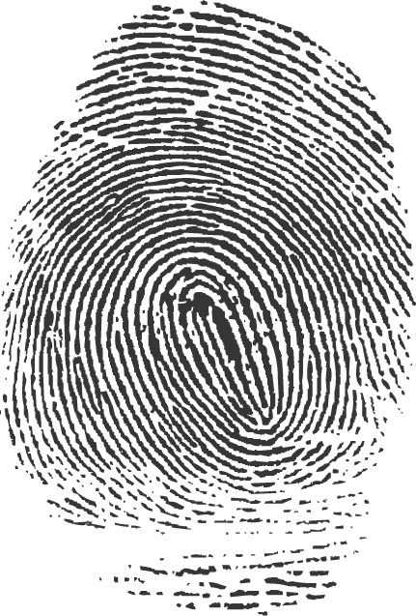
Can we extract an organic fingerprint?
Climate/soil
Pathogens
?
Genetics
Crop management
Fertilization

Slide 3
Complementary analytical techniques
Trace elements
Metabolites
?
Stable isotopes
Pesticide residues
Compound-specific isotopes
Laursen et al. (2014) TrAC. 59, 73-82.
Capuano et al. (2012) J. Sci. Food & Agric. 93, 12-28
Mihailova et al. (2012) Food Sci. & Tech. 26, 26-28

Slide 4
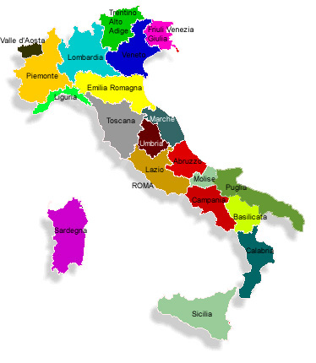
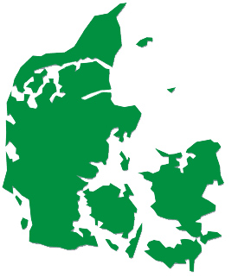
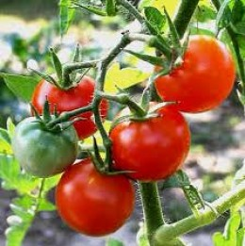
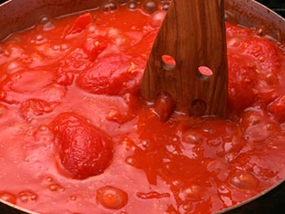
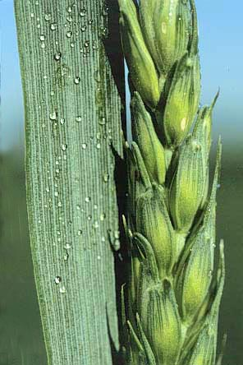
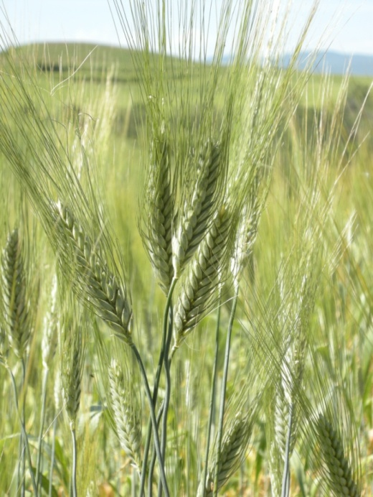
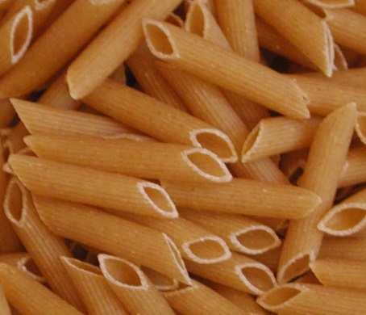
Organic food authentication - samples
+ relevant samples from
related research projects

Slide 5
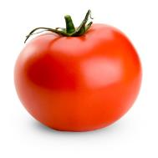
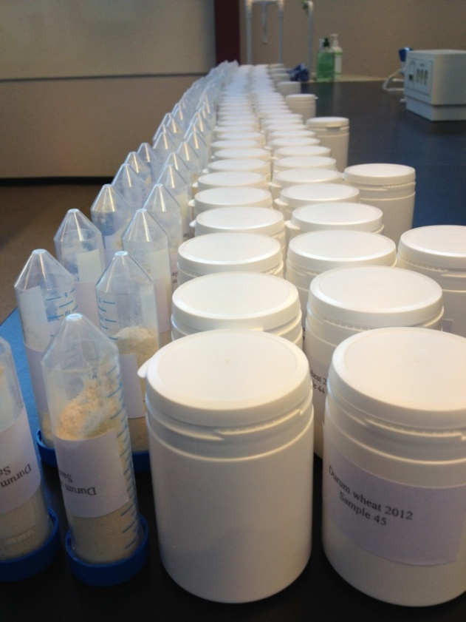
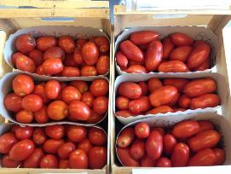
AuthenticFood sample flows
Homogenized samples to:
Italy
The United Kingdom
Denmark
Czech Republic
Fresh samples to:
The Netherlands (analysis)
Luxembourg (analysis)
Denmark (sample preparation)
Sites of production:
Northern Italy
Southern Italy
Denmark (test-set)
Tomato sauce production:
Central Italy
Tomato sauce to:
Denmark
France
Italy
Czech Republic
Luxembourg

Slide 6
AuthenticFood preliminary conclusions
Trace elements
Laursen et al. (2011) J. Agric. Food Chem. 59, 4358-4396
Metabolites
Mie et al. (2014) Anal Bioanal Chem. 406:2885-2897
Novotna et al. (2012) Food Addit. & Contamin. 29, 1335-1346
Stable isotopes
Mihailova et al. (2014) Food Chem. 154, 238-245
Laursen et al. (2013) Food Chem. 141, 2812-2820
Pesticide residues
Compound-specific isotopes

Slide 7
AuthenticFood activities the final 5 months
Final analytical and statistical analyses
Final project meeting (Trento, Nov 25-26th)
Various dissemination activities
Recommendations to end-users
National and international workshops
Presentation of results at international conferences
Submission of final AuthenticFood publications
Final project report
Related/future projects:
www.foodintegrity.eu
COM-ISO http://plen.ku.dk/english/research/plant_soil/nutrition/com-iso/

